Slide 1

RL in MATLAB
TourandaZ
Abbasi

Slide 2
Reset and Step Functions

Slide 3
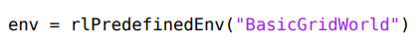
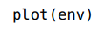
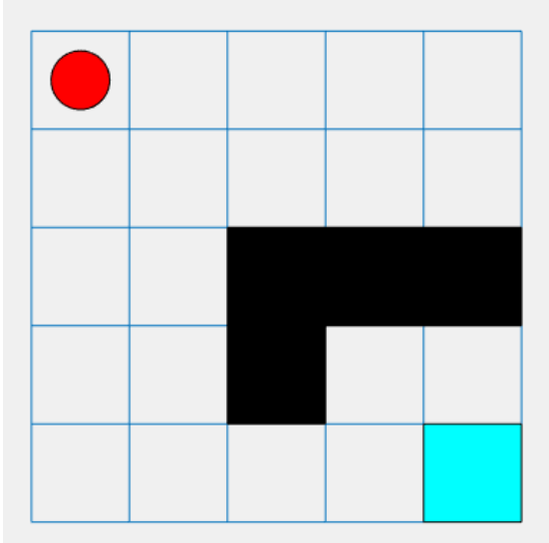
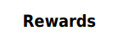
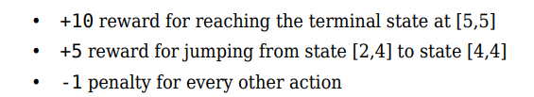

Slide 4
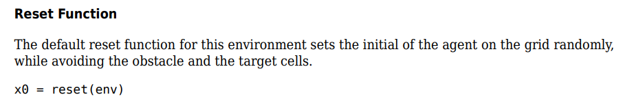
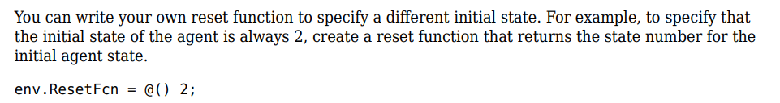

Slide 5
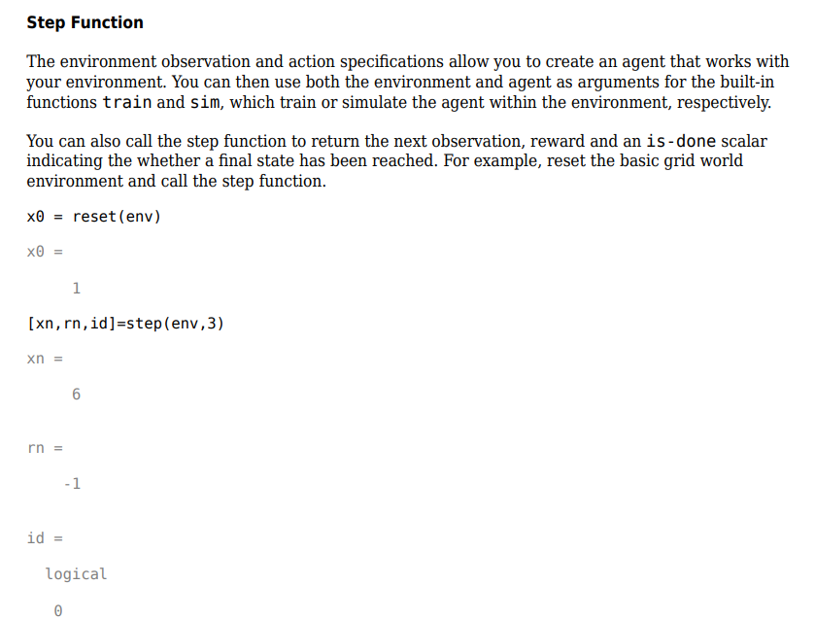

Slide 6
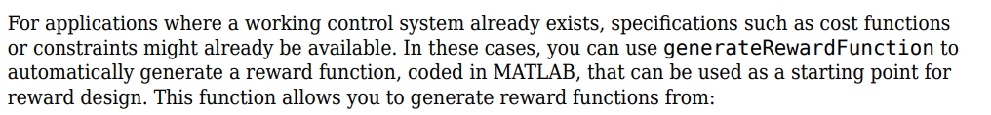

Slide 7
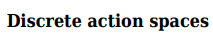
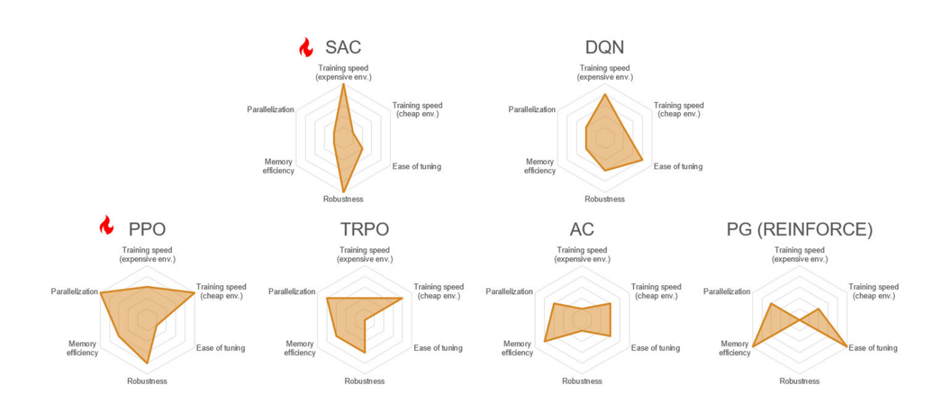

Slide 8
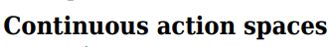
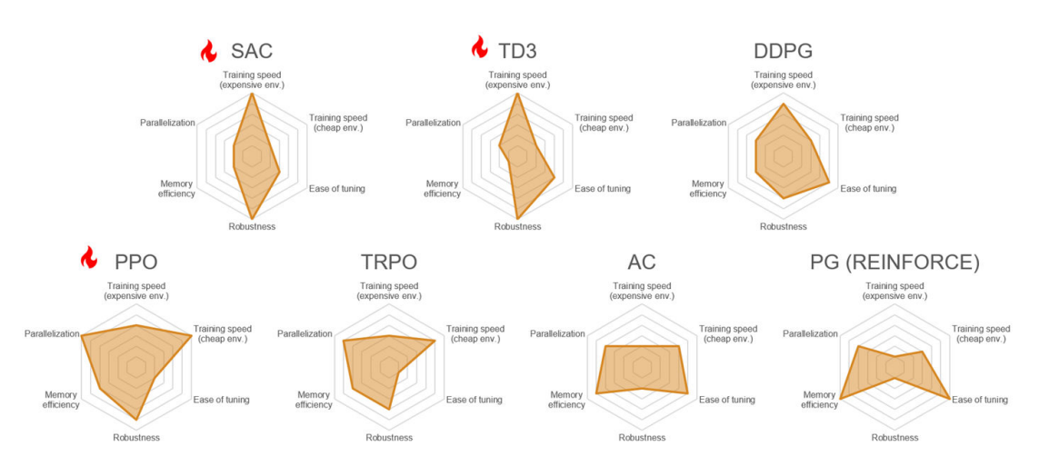

Slide 9
Policy Objects

Slide 10
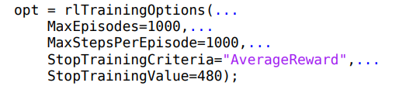

Slide 11
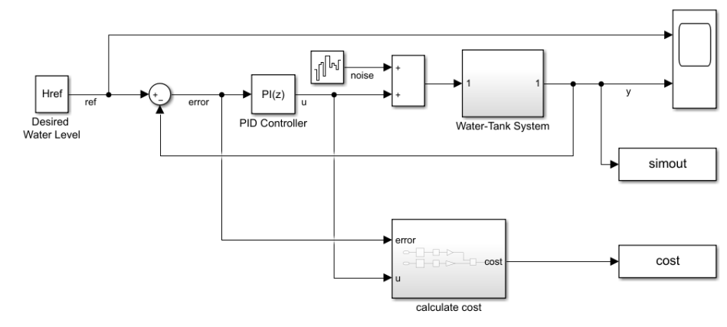

Slide 12
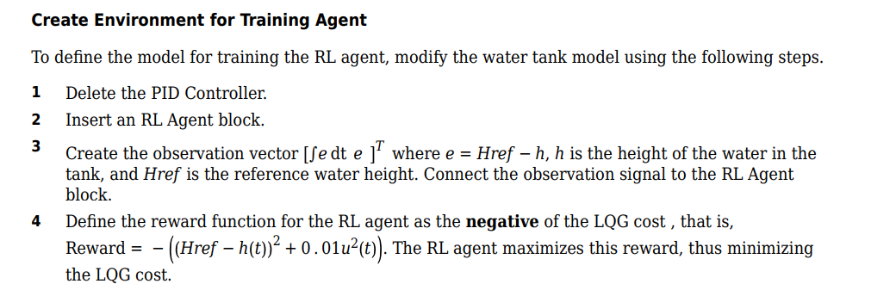

Slide 13
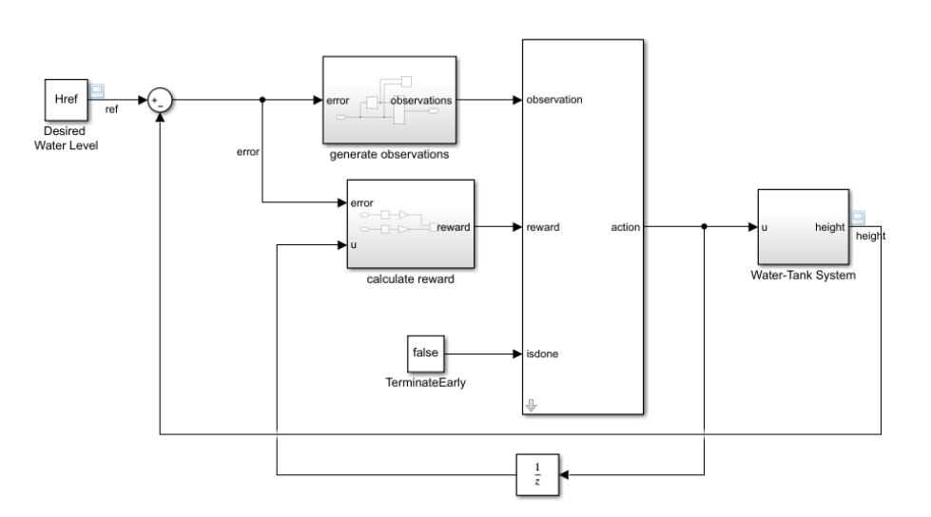

Slide 14
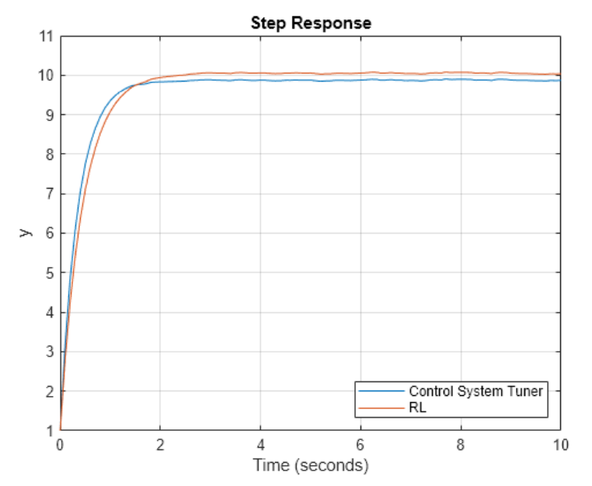

Slide 15
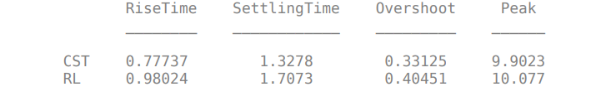

Slide 16
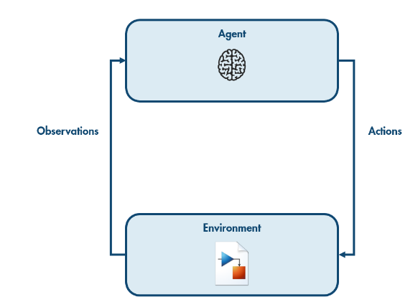
How the environment reacts to the agent's actions is typically simulated using a Simulink model of the environment's dynamics.

Slide 17
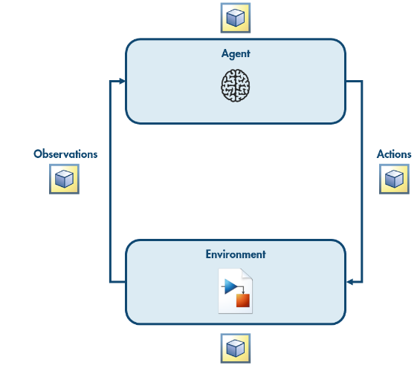
The agent, the environment, the observations, and the actions are all represented in MATLAB as variables.

Slide 18
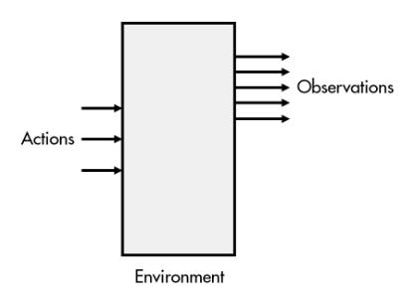
Connecting a Simulink Environment to a MATLAB Agent
To create a reinforcement learning environment, you will typically start with a Simulink model of the environment dynamics. The actions will control the inputs to the system. Observable variables will be the outputs.

Slide 19
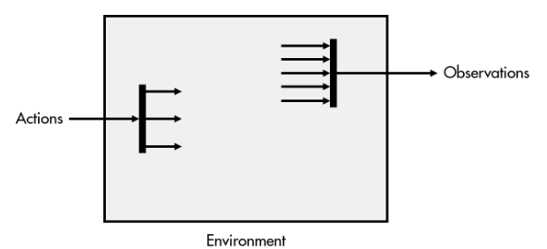
Connecting a Simulink Environment to a MATLAB Agent
When using an RL agent, the actions and observations are each single signals. You can use something like a Vector Concatenate block to combine the individual observations into a single array. You can use Selector blocks to split the action signal into individual actions.

Slide 20
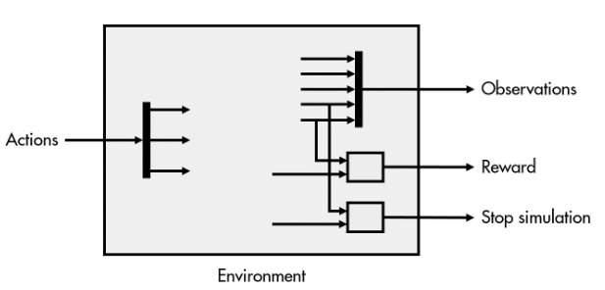
Connecting a Simulink Environment to a MATLAB Agent
The environment also needs to provide the reward. This is typically calculated from the observable variables and sometimes the actions. However, the reward may also depend on other environment variables that are not observable to the agent.
Similarly, the environment needs to determine whether the simulation should terminate, such as when the target reaches 0 in the dice game, or if the robot crashes into an obstacle. As with the reward, the termination condition may depend on the observable variables or other internal variables.

Slide 21
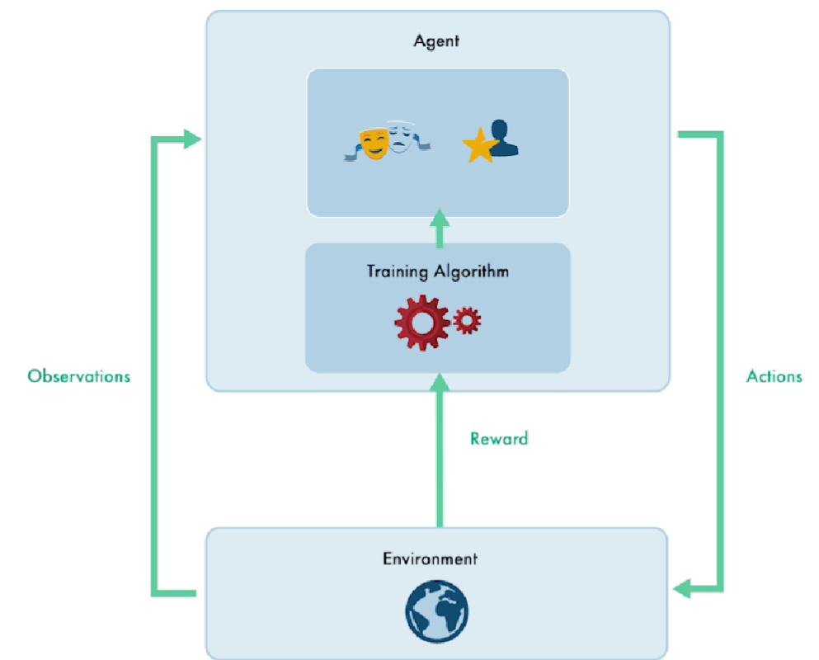
How Training Algorithm Works

Slide 22
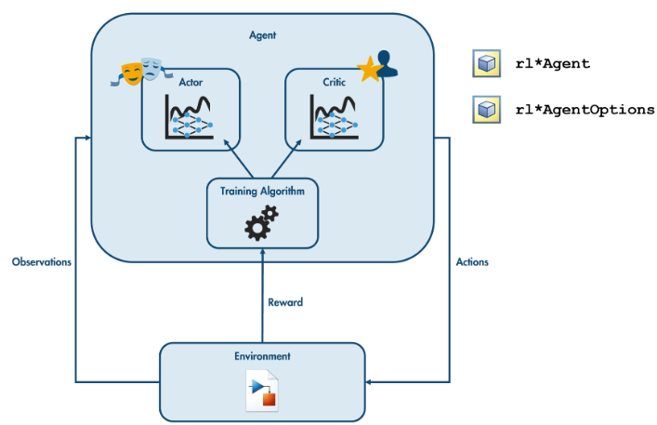
Agents
You can create different kinds of agents with the various rl*Agent functions. Each of these functions has a corresponding rl*AgentOptions function you can use to control how your agent learns.

Slide 23
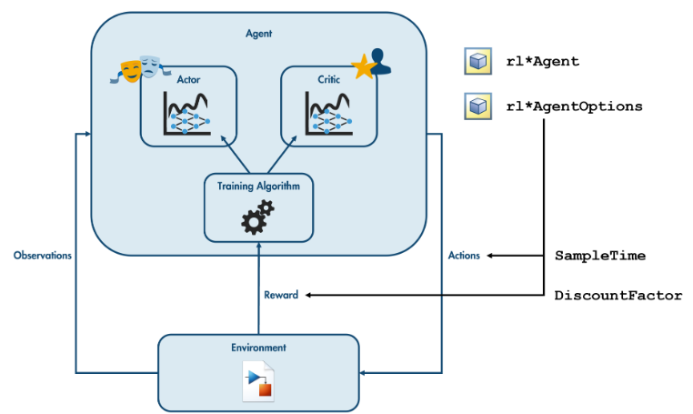
Agent Options
For all agents, you can set the discount factor and the sample time.
The discount factor determines how the rewards at the individual time steps are weighted. This allows you to make the agent more short- or long-sighted.
The sample time determines how frequently the agent interacts with the environment. The Simulink model simulates the dynamics of the environment through time, choosing the time steps at which to update the internal state of the environment. This is independent of the agent's sample time. Regardless of the internal dynamics of the environment, the agent receives observations and takes an action once every increment of SampleTime.

Slide 24
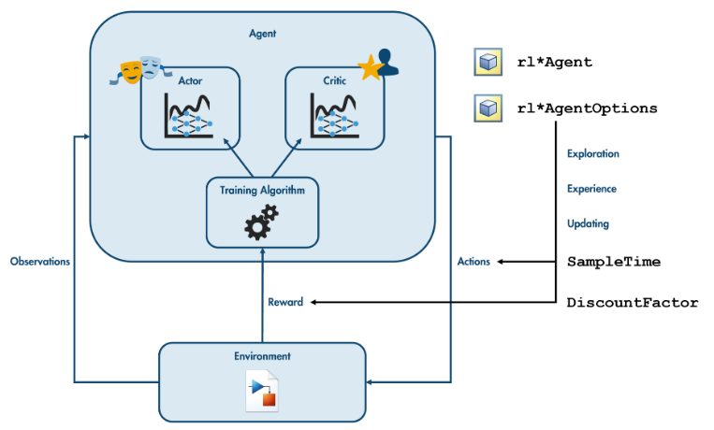
Agent Options
Each agent also has specific options. Generally speaking, these control how the agent:
explores the space of possible states and actions, by taking actions either according to the policy or at random
stores and uses previous experiences to learn
updates its policy, such as how frequently an actor-critic agent should update the critic

Slide 25
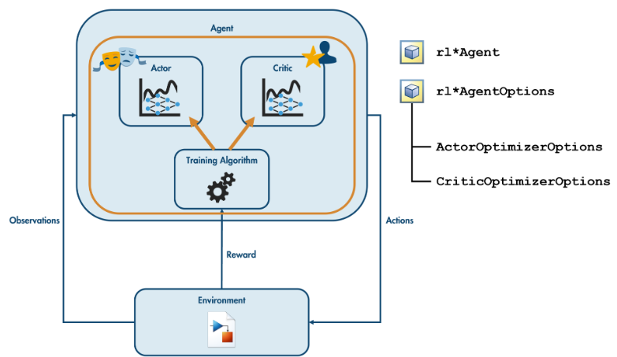
Agent Options
You can also specify the options that control how your agent's actors and critics are updated during training.
In particular, you will often need to adjust the learning rate (the LearnRate option), which determines how aggressively the parameters are changed in response to new experience.
Training typically uses some form of gradient descent to adjust the parameters. How much the parameters are changed is therefore related to both the learning rate and the size of the gradient. You can limit the size of any update by using the GradientThreshold option to set an upper bound on the size of the gradient.
The gradient descent algorithm is ultimately an optimization algorithm (in this case minimizing the error in the actor or critic's desired output). Hence, the options are stored in the ActorOptimizerOptions and CriticOptimizerOptions properties of the agent options.

Slide 26
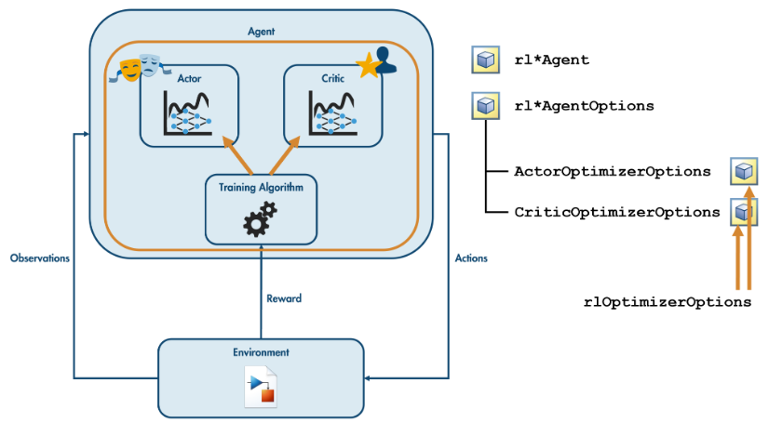
Agent Options
You can use the rlOptimizerOptions function to create variables to hold the settings for your actors and critics. Use these variables as the value of the agent's ActorOptimizerOptions and CriticOptimizerOptions properties.

Slide 27
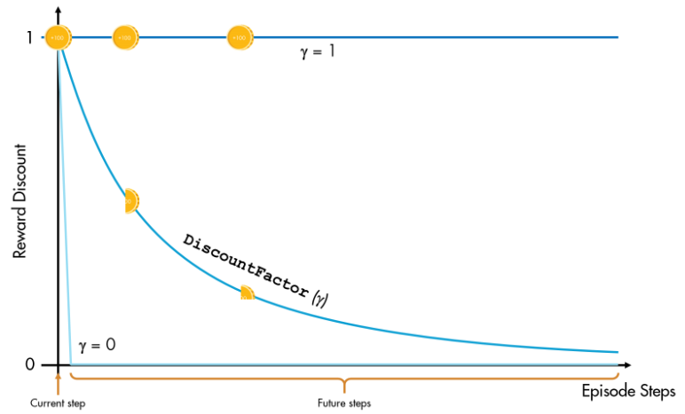
Weighting future rewards
A discount factor of 1 means that all future rewards are equally weighted. A factor of 0 means only the immediate reward is considered. A value between 0 and 1 means future rewards are discounted exponentially with time. In MATLAB, agents have a default discount factor of 0.99.

Slide 28
For the dice game, the goal is to reach the target in as few steps as possible. This means the agent should consider the reward for the entire episode. To make an agent as far-sighted as possible, set the reward discount factor to its maximum value (1)

Slide 29
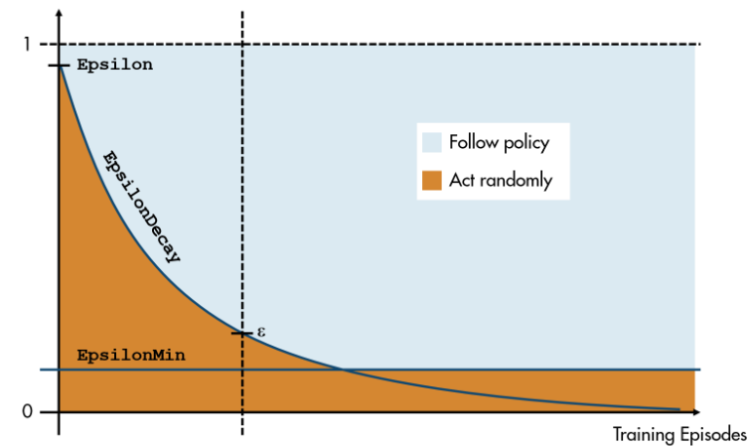
Random Exploration (epsilon-greedy)
Typically you want to explore more at the start of training and less once the agent has started to build an estimate of the Q value function. A common approach is to start with a high value of ε, then decrease it after each training episode, usually with some minimum threshold to ensure that the agent continues to explore, even after many training episodes.
The initial value of ε, the rate at which it decreases, and the minimum value are all parameters that control how a Q-Learning agent trains.

Slide 30
When the warehouse robot is trained with the default options, the episode rewards seem to jump around randomly. The robot is not learning anything useful. This can indicate that the training algorithm is being too aggressive in how it updates the agent. Common ways to address this is to lower the learning rate or put a cap on the size of the gradient.

Slide 31
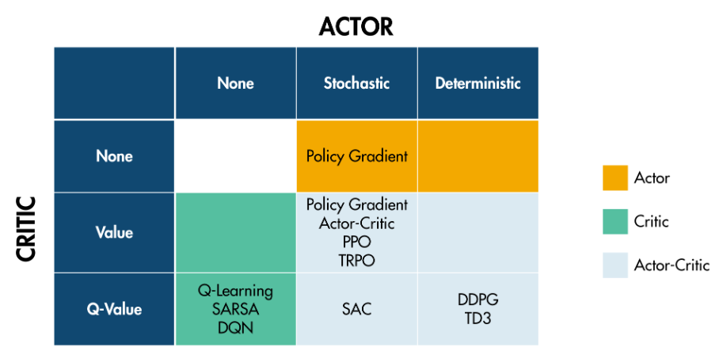
Actor-Critic Agents
There are various types of actor-critic agents, each using a particular architecture for the actor and critic networks. Unless you are building custom neural networks for your actors and critics, you do not need to worry about the different types of actors and critic networks. Typically, you will be able to create your agent by specifying just the observations and actions, resulting in an agent with default actor and critic networks chosen for you.

Slide 32
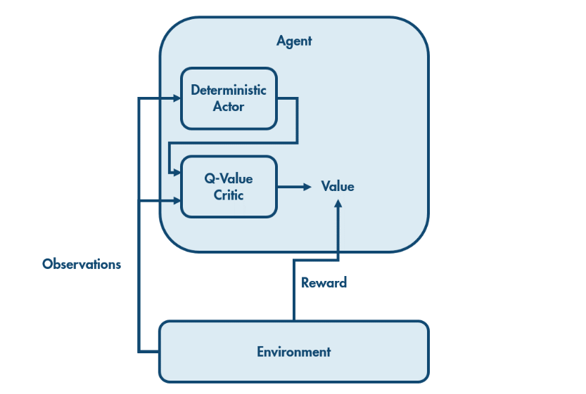
Deterministic Actor and Q-Value Critic
The environment provides a reward to the agent, and the agent observes the new state of the environment.
The actor uses the new state to determine a new action. This action and the new state are passed to the critic, which determines the value. That is, the critic estimates how much reward the agent will receive in the future from this situation. Combining this with the observed reward gives an updated estimate of the value of being in the original state.

Slide 33
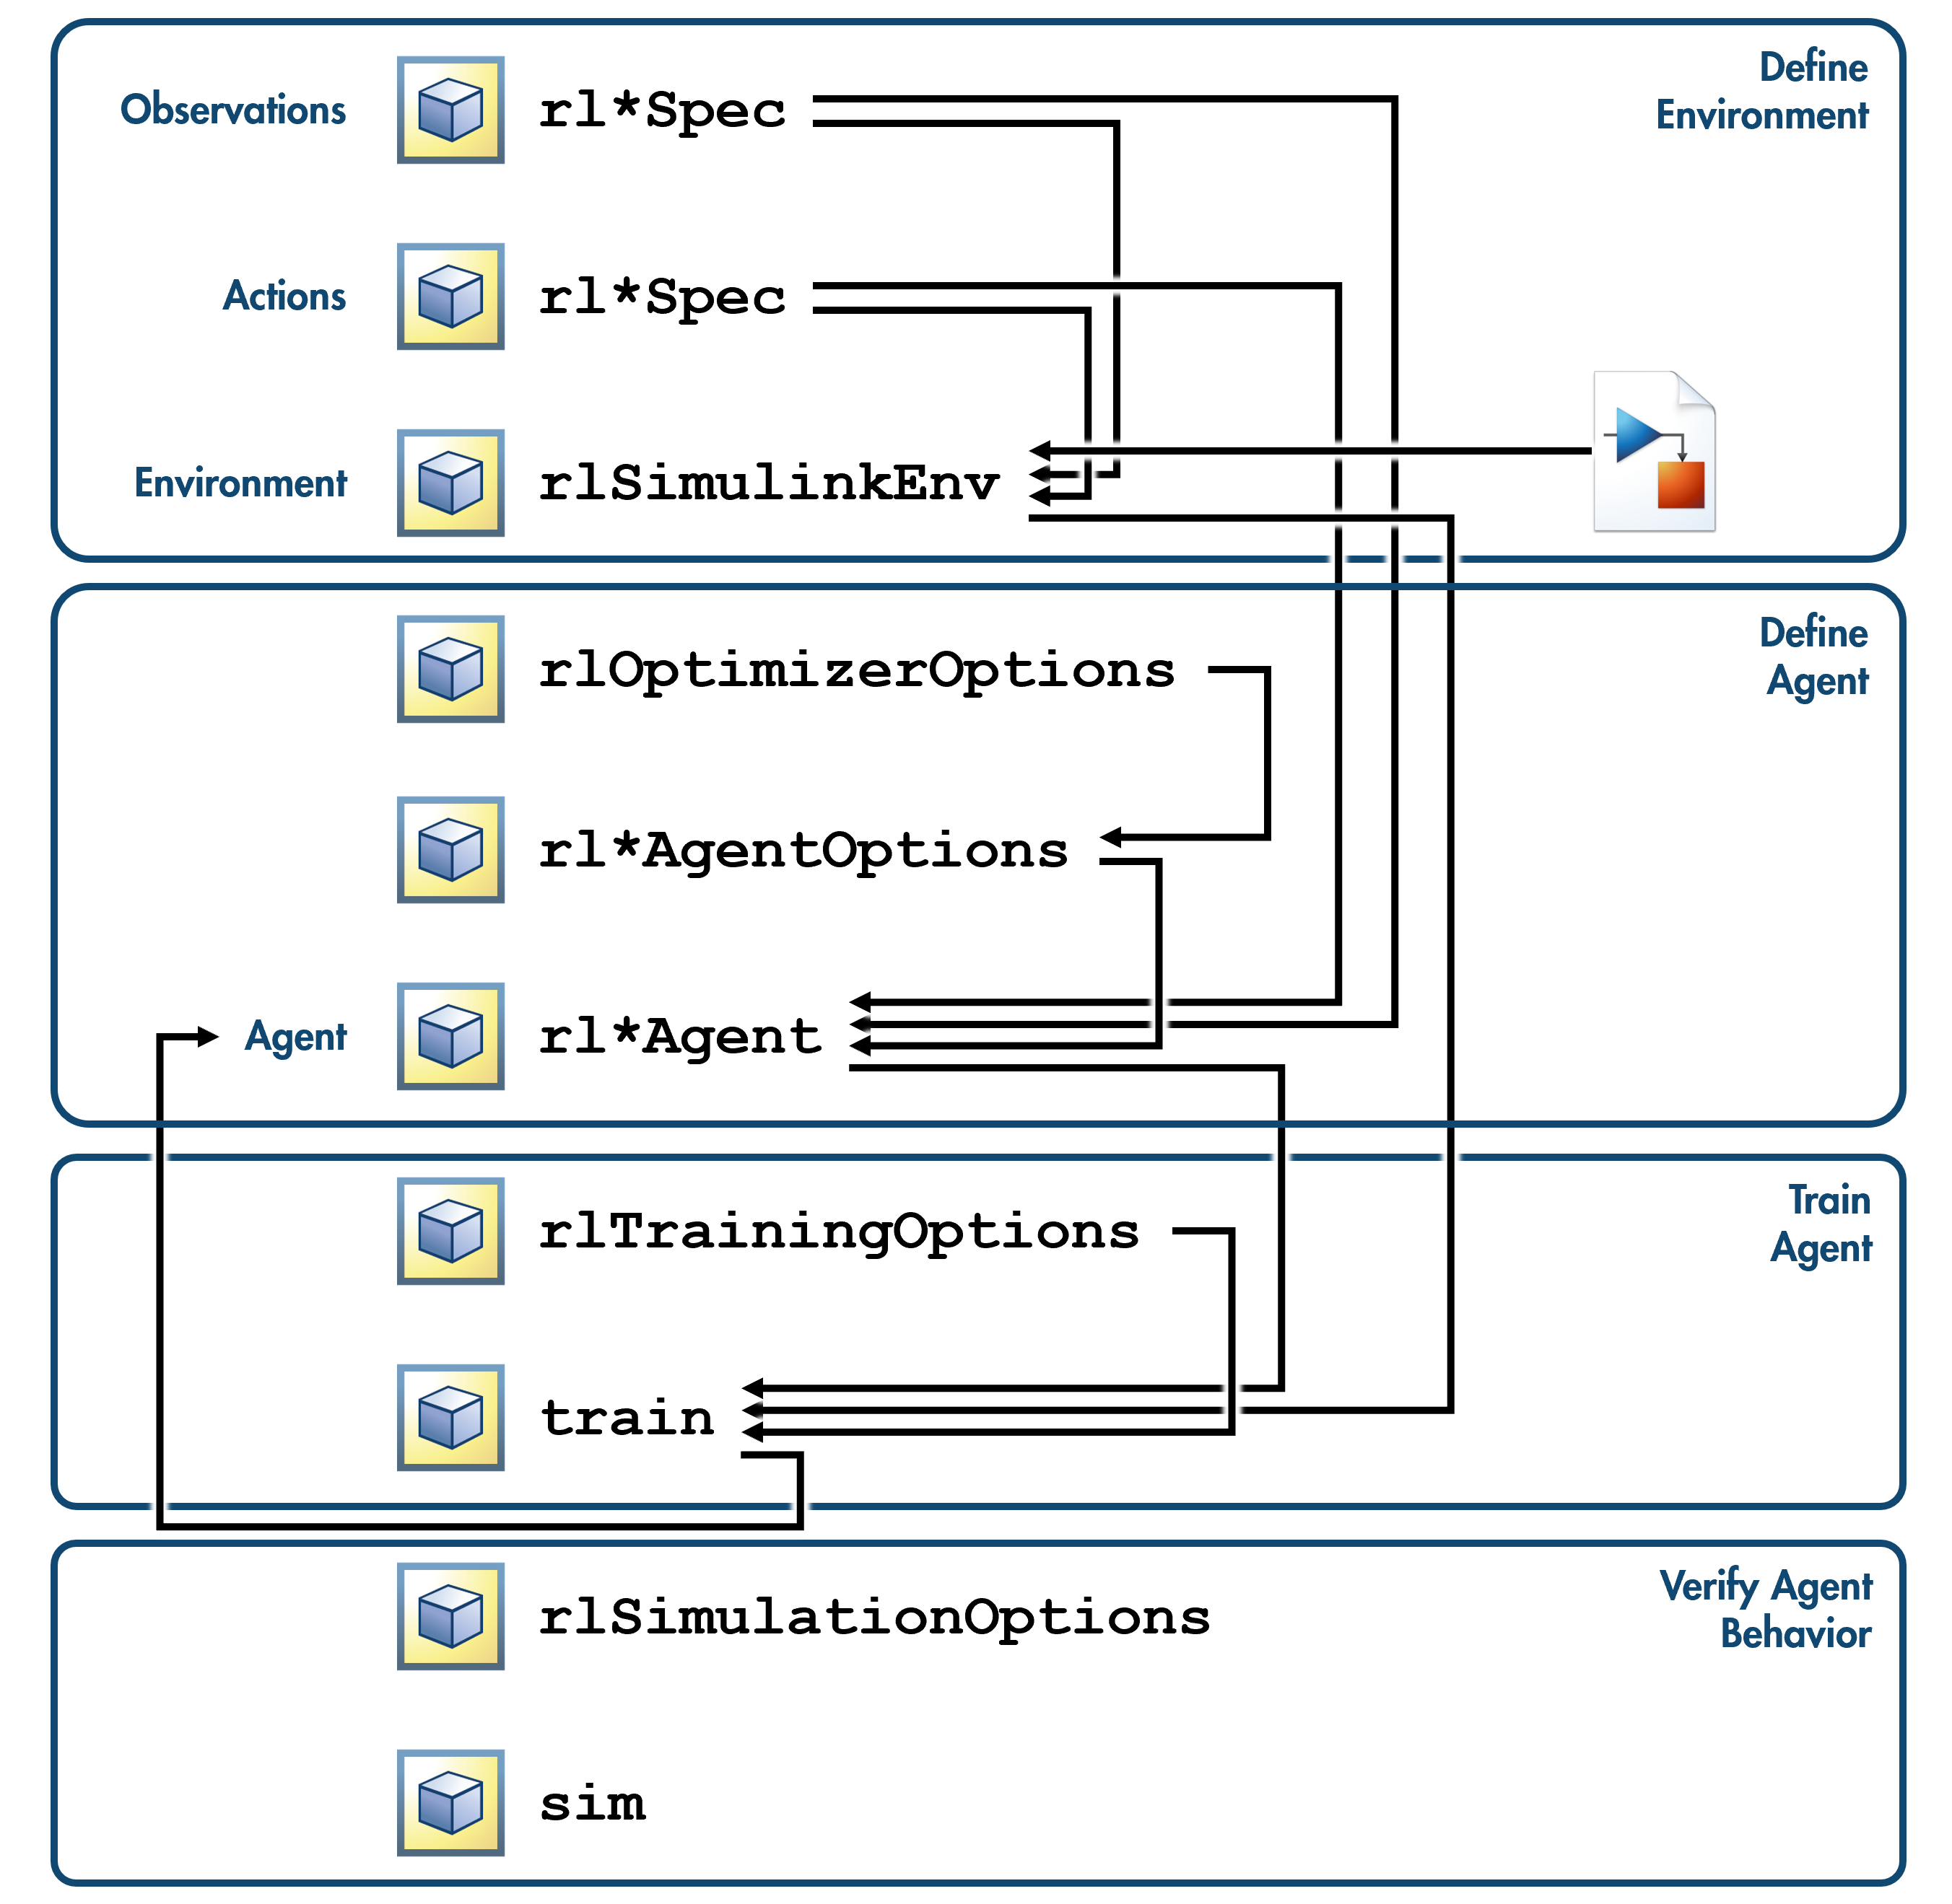
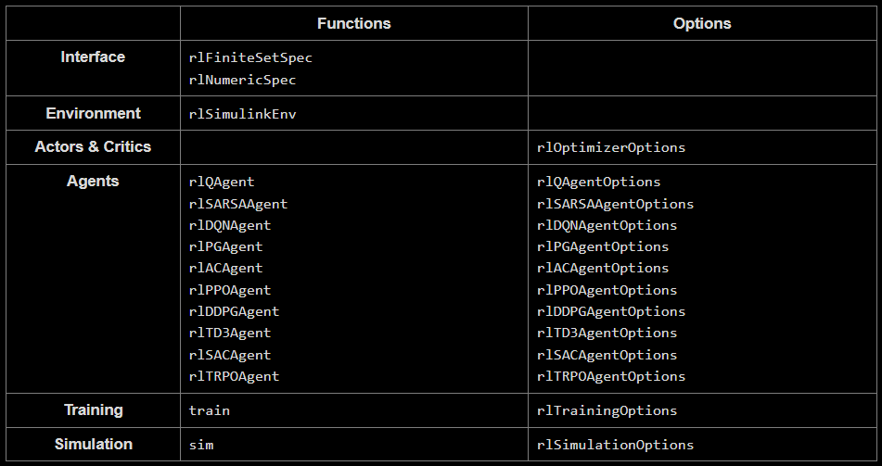
Conclusion

Slide 34
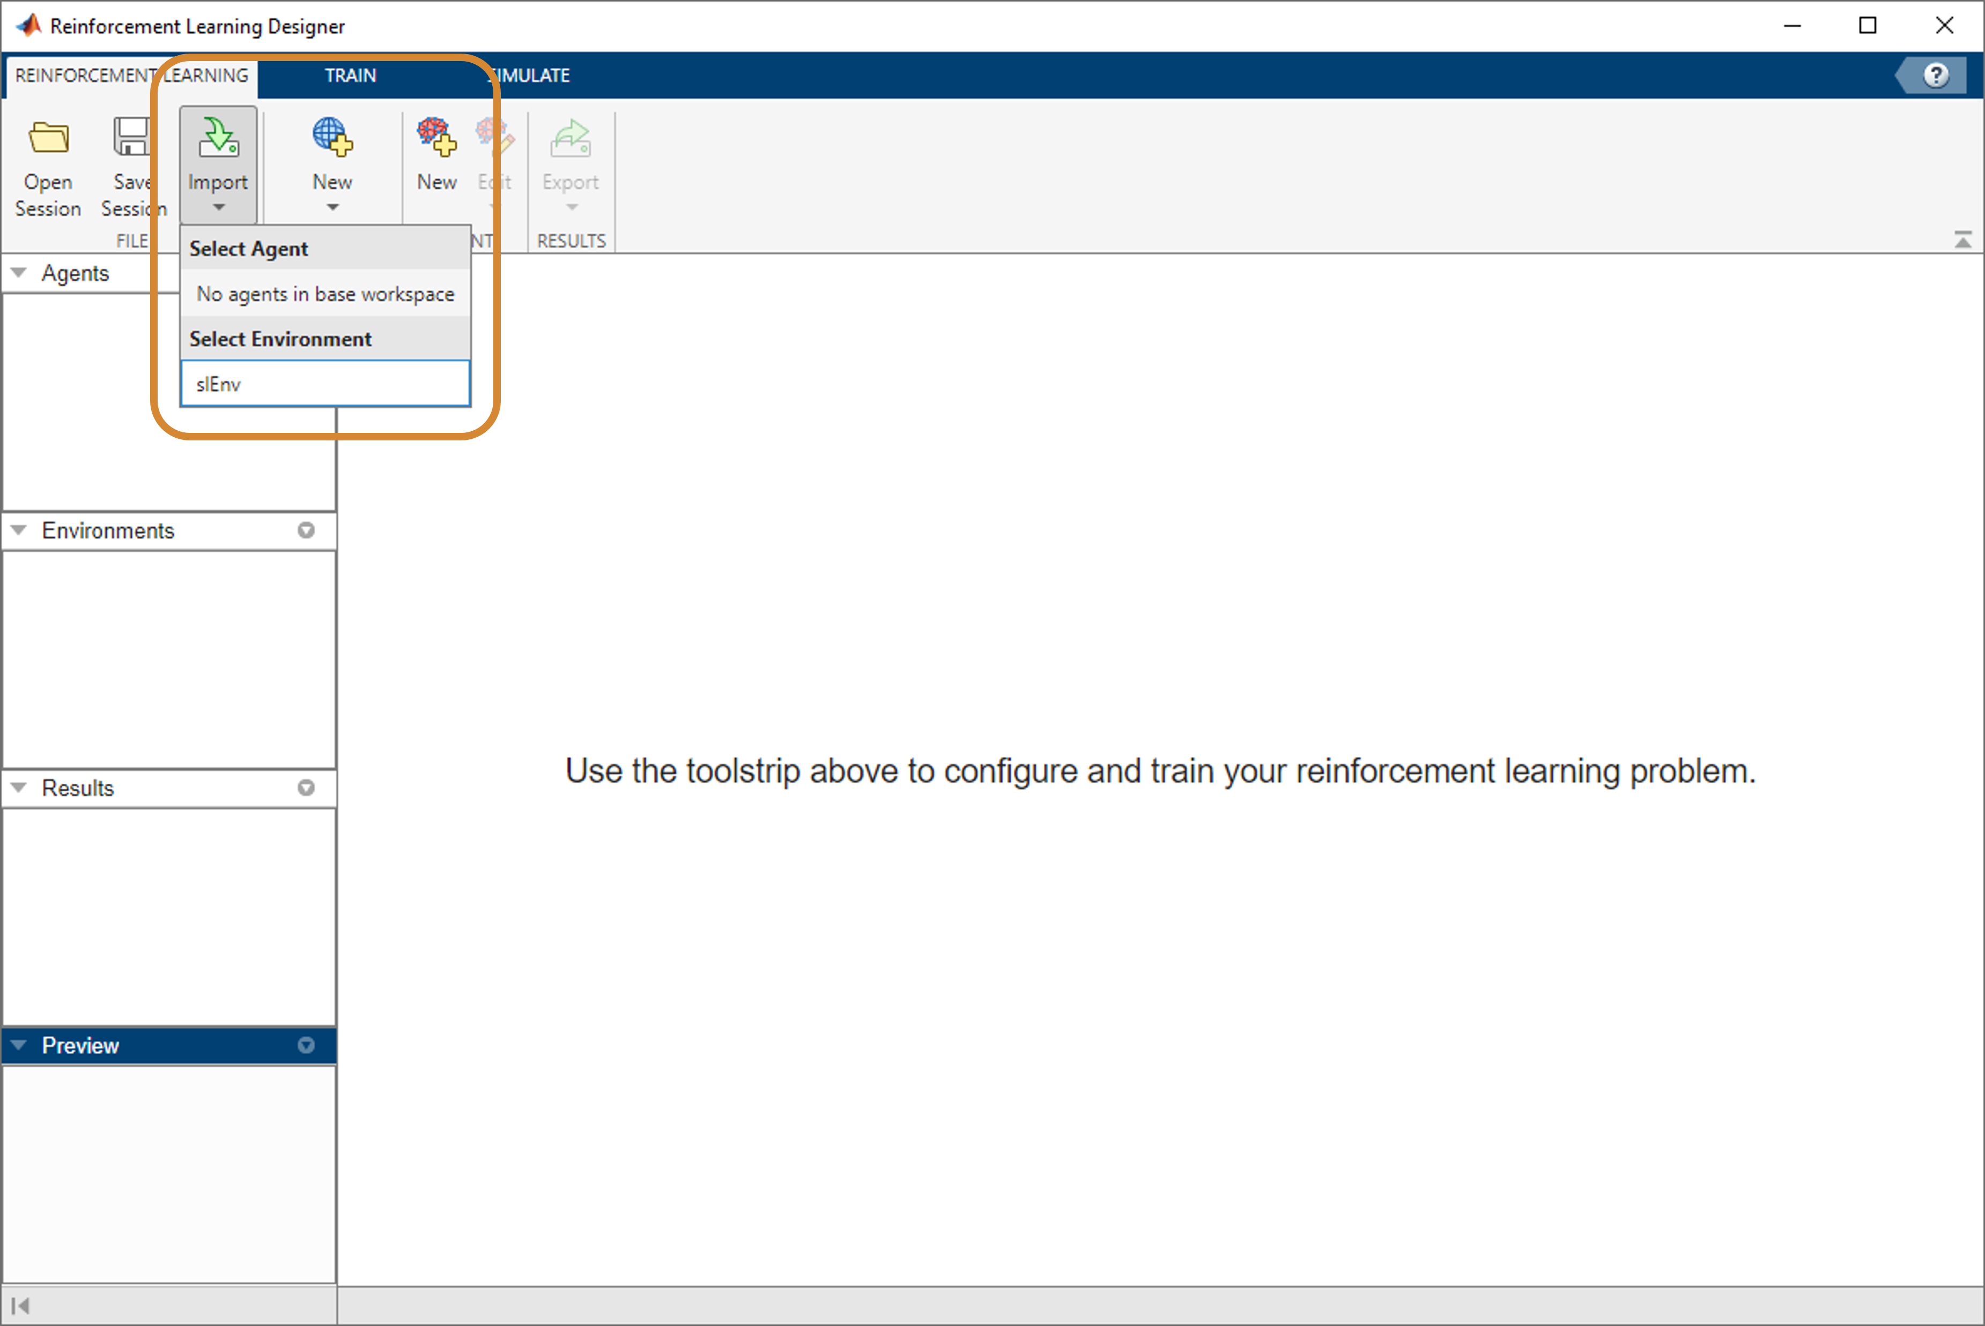
Reinforcement Learning Designer
Rather than do everything programmatically, you can also build and train agents in the Reinforcement Learning Designer, which you can start from the Apps tab in the MATLAB toolstrip.
You can import agent and environment variables from the MATLAB workspace.

Slide 35
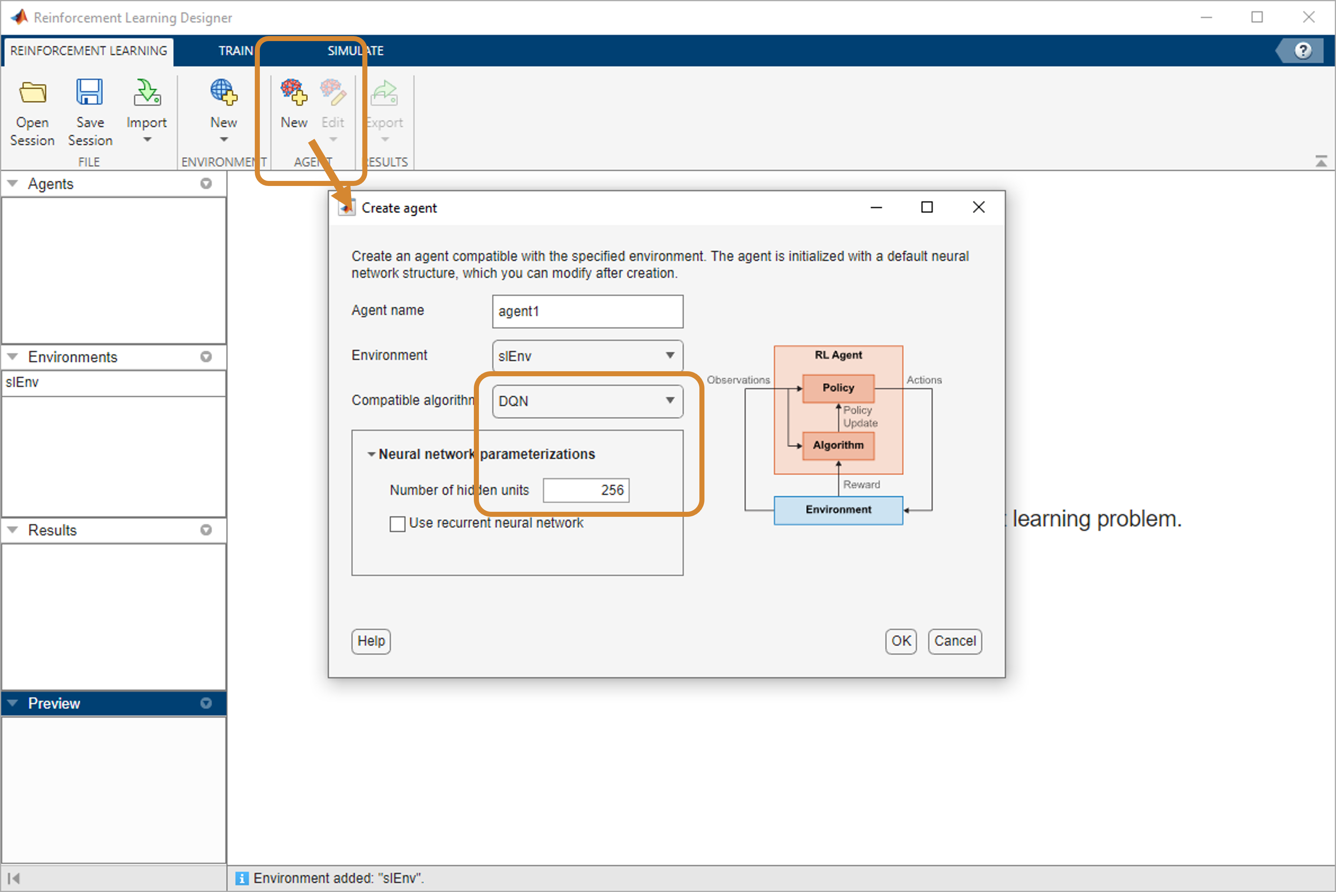
Reinforcement Learning Designer
You can import agent and environment variables from the MATLAB workspace. You can create new agents directly in the app. The Compatible algorithm menu lists only the types of agents that are valid for your environment.

Slide 36
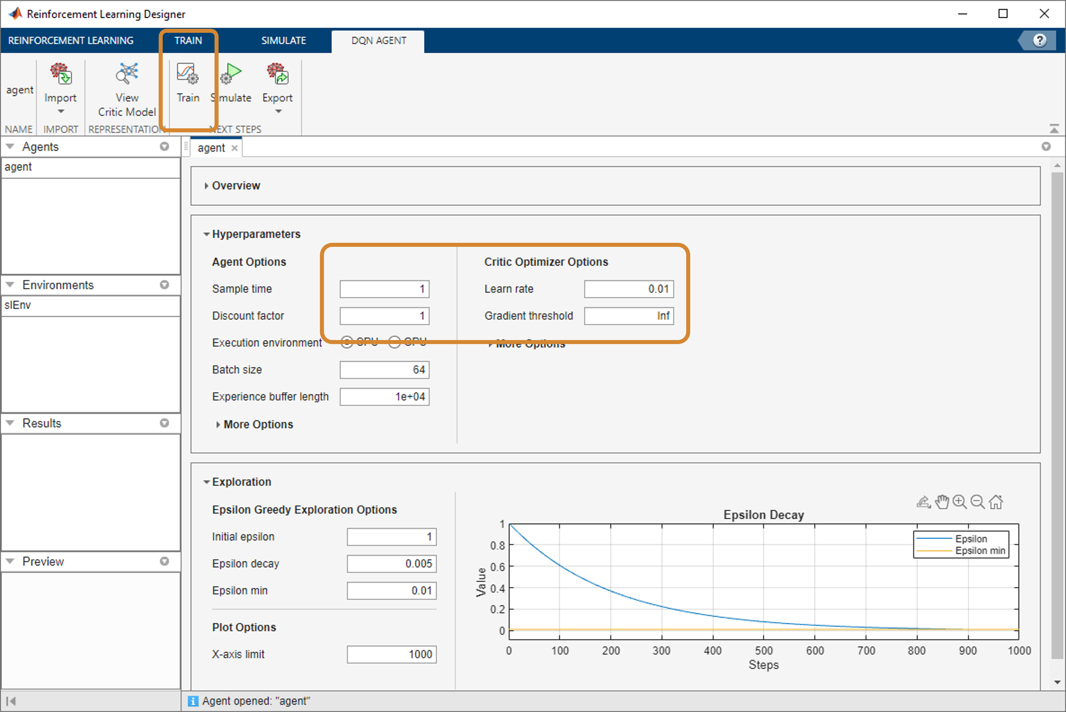
Reinforcement Learning Designer
Once you have an agent, you can set the options, including those for the actor and critic. Once you are satisfied with your settings for the agent, click Train.

Slide 37
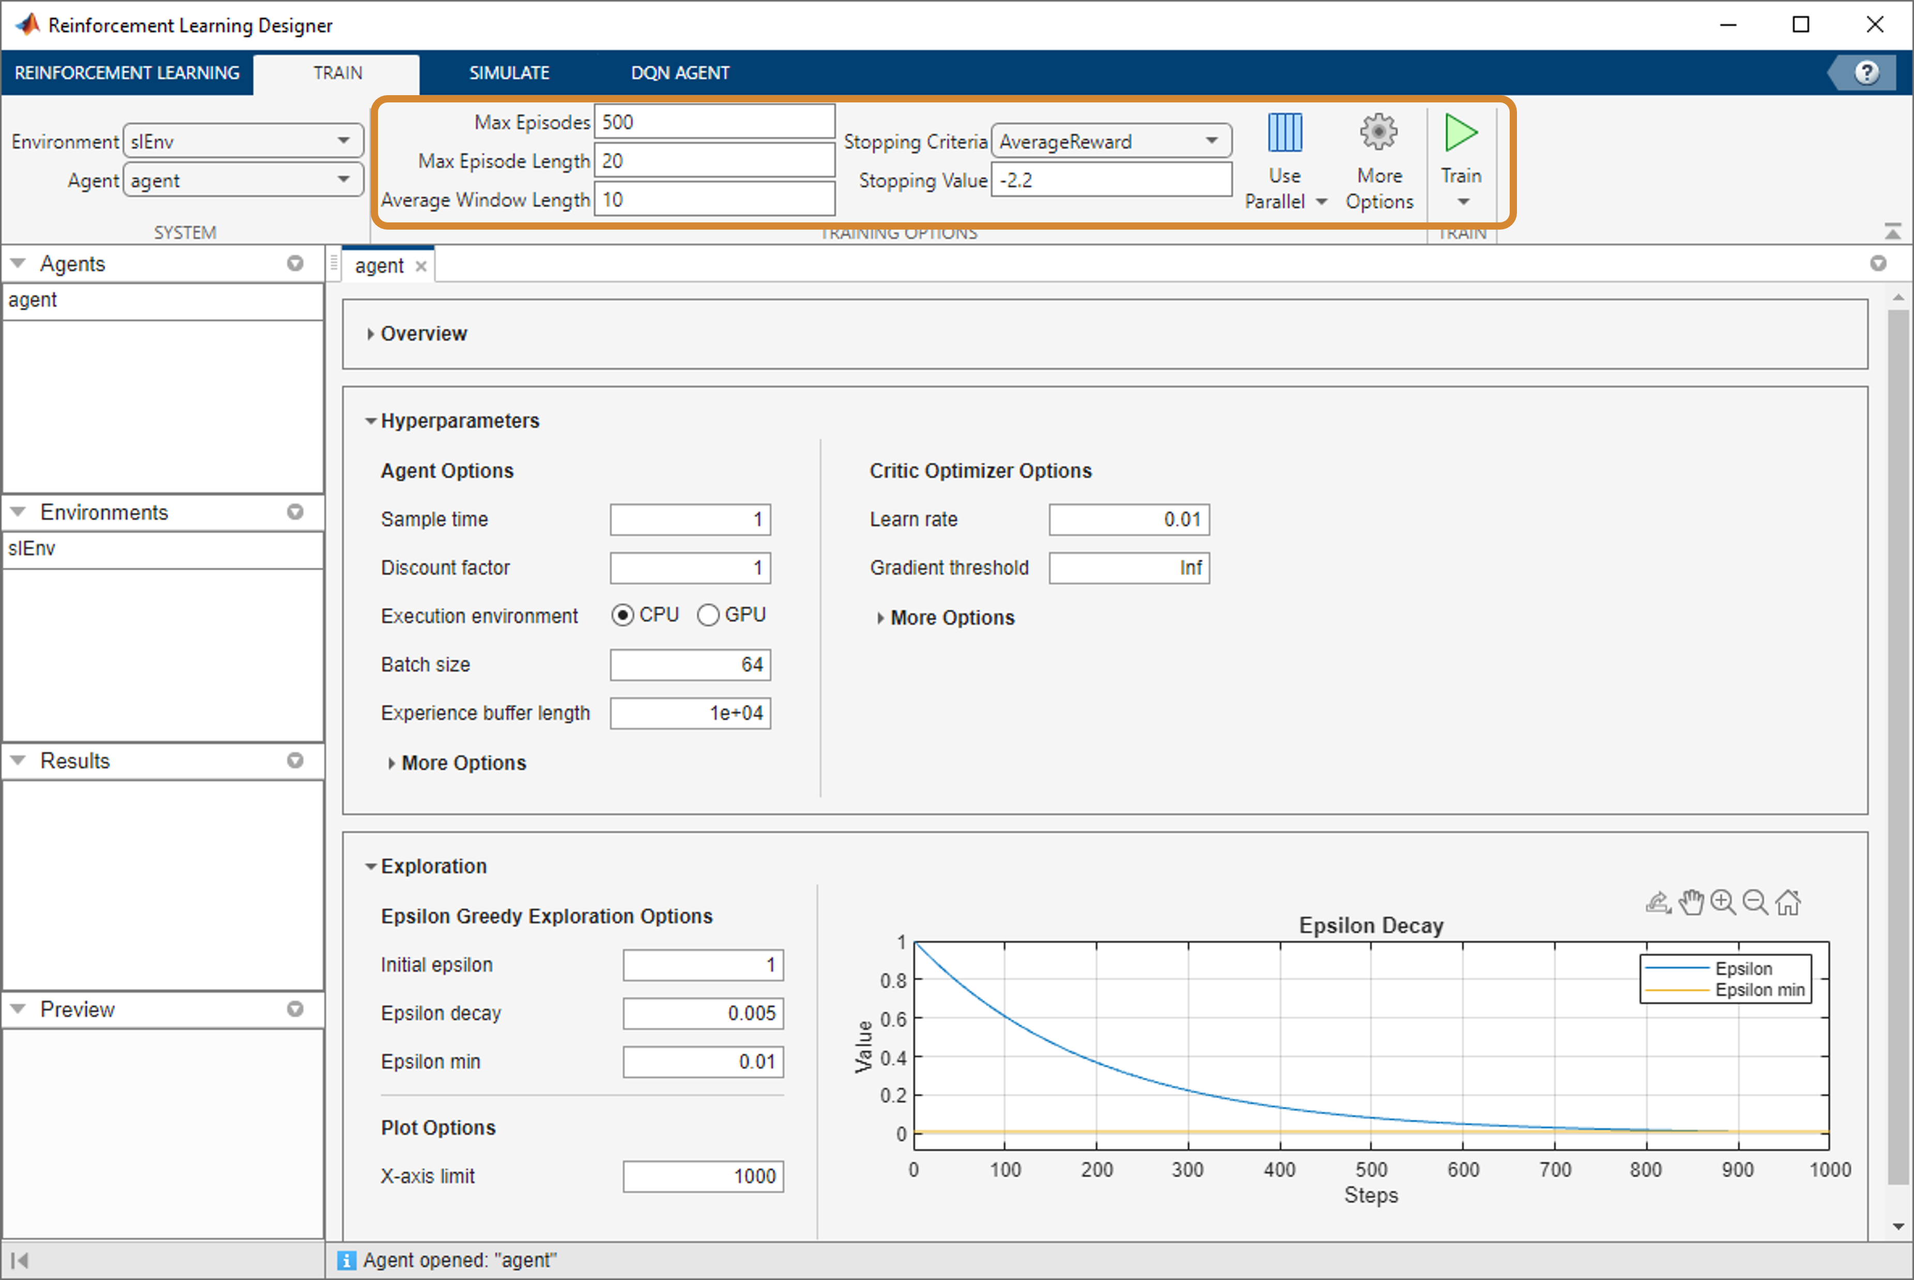
Reinforcement Learning Designer
You can set options and start training.

Slide 38
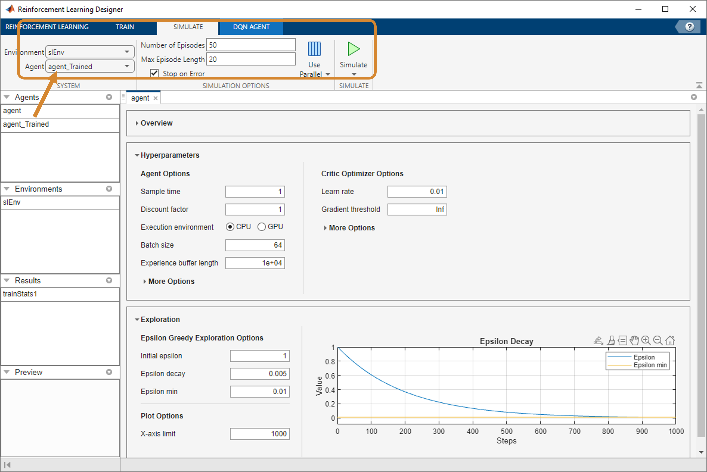
Reinforcement Learning Designer
Once training is complete, you can simulate with the trained agent to verify its behavior.

Slide 39
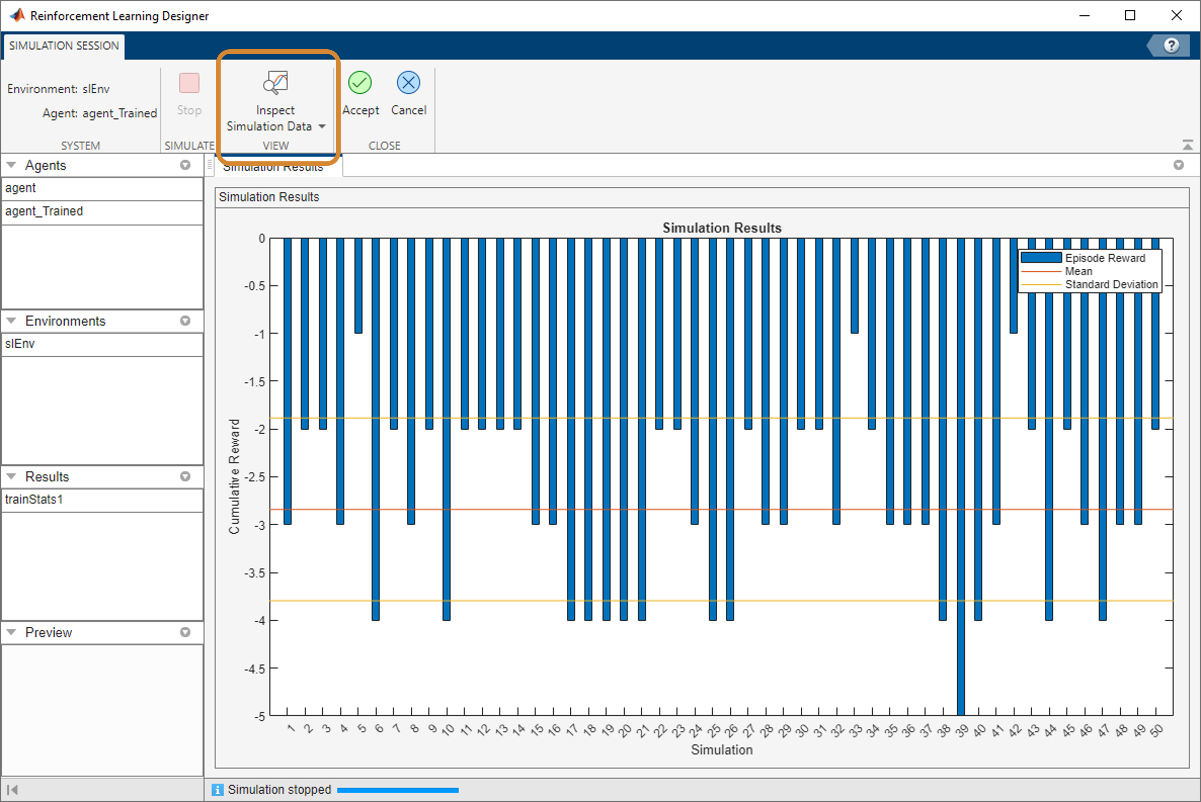
Reinforcement Learning Designer
You can see a summary of the simulation results or look in detail at individual simulations to see the observations, actions, and rewards.

